Slide 1



Presidency University
IMAGE
CAPTION
GENERATOR

Slide 2

WHAT IS IMAGE CAPTION GENERATOR?
Image caption generator is a task that involves computer vision and natural language processing concepts to recognize the context of an image and describe them in a natural language like English.

Slide 3

TABLE OF CONTENT
Abstract
Introduction
Methodology
Model
Literature Review
Result
Conclusion

Slide 4


ABSTRACT
For this project, we use CNN and LSTM to become aware of the caption of the image.
Image caption generation is a system that comprehends natural language processing & computer vision standards to recognize the connection of the image in English.
In this research, we cautiously pursue a number of important concepts of photograph captioning and its familiar processes.We also talk about flickr_dataset and CNN used for photo classification.

Slide 5
INTRODUCTION
Image captioning is one of the most needed requirementsof today’s world. Moreover, there are some inbuilt applications that generate and provide a caption for a certain image, all these things are done with the help of deep neural network models. The process of generating a description of an image or the process by which we get to know moto of image is called image captioning. Using CNN it detects the important objects, their attributes and also relation among them in respective image. This project will also elaborate on the functions and structure of the various Neural networks involved. Generating image captions is an important aspect of Computer Vision and Natural language processing.

Slide 6


METHODOLOGY
We are using CNN to detect different objects in given image and LSTM to predict the sequence of words and in turn generate the caption for given Image.
CNN is used for extracting features from the image. CNN-Convolutional Neural networks are specialized deep neural networks which can process the data that has input shape like a 2D matrix.Images are easily represented as a 2D matrix and CNN is very useful in working with images. CNN is basically used for image classifications and identifying if an image is a bird, a plane or human, etc. It scans images from left to right and top to bottom to pull out important features from the image and combines the feature to classify images. It can handle the images that have been translated, rotated, scaled and changes in perspective.

Slide 7
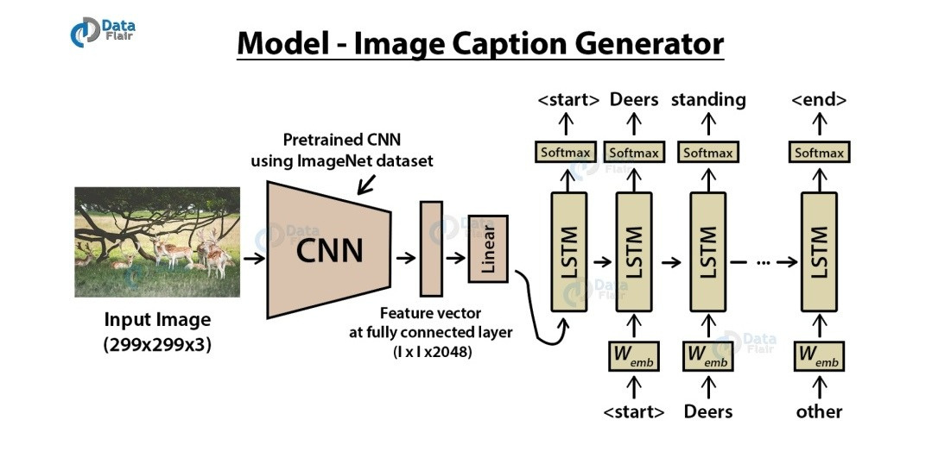

Slide 8
CNN-Convolutional Neural networks are specialized deep neural networks which can process the data that has input shape like a 2D matrix. Images are easily represented as a 2D matrix and CNN is very useful in working with images.
LSTM - Long short term memory, they are a type of RNN(recurrent neural network), which is well suited for sequence prediction problems. LSTM can carry out relevant information throughout the processing of inputs and with a forget gate it discards non-relevant information.

Slide 9
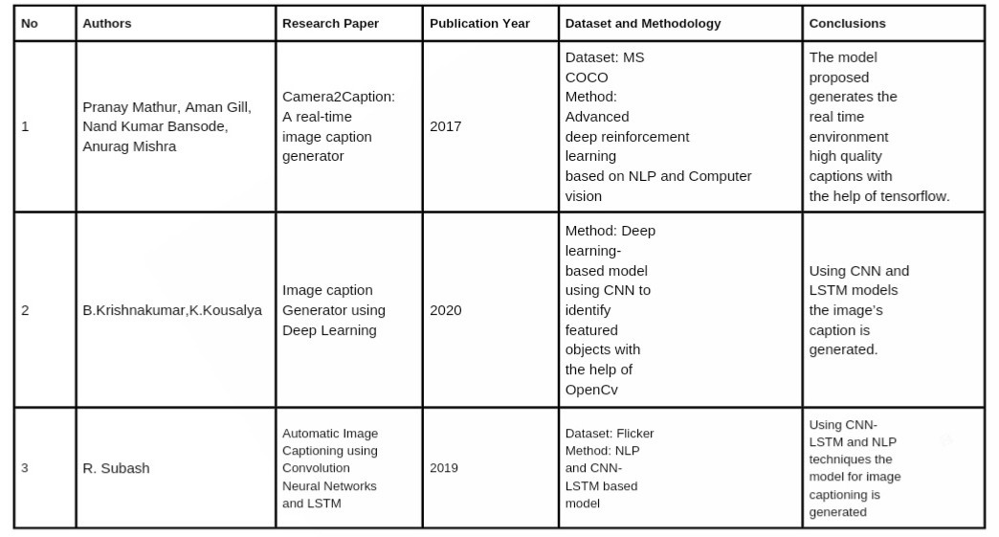
LITERATURE REVIEW

Slide 10
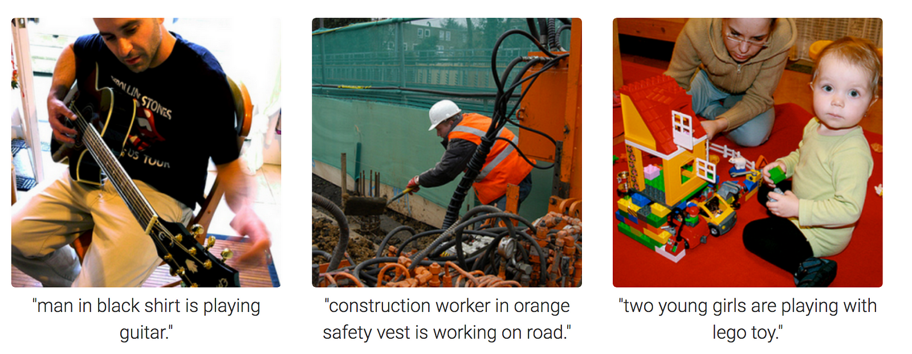
RESULT

Slide 11
CONCLUSION
This model based on multi label classification using fast Text and CNN, is useful in detecting and extracting objects from image and generate caption according to the provided datasets. We have presented multiple approaches for Image caption Generator like (Convolution neural network, Long short-term memory).
The model was built on the idea of generating the captions for the input pictures. This model can be used for a variety of applications. In this, we studied about the CNN model, RNN models, LSTM models, and in the end, we validated that the model is generating captions for the input pictures.

Slide 12

THANK YOU
Team Members | Team Members
SAI MITHUN B | 20201CSG0034
JAYANTH SR | 20201CSG0025
SHARAJ OV | 20201CSG0029
PRAMOD N | 20201CSG0027

